Slide 1
Boosting Algorithm
Regression

Slide 2
Boosting Algorithm
Purpose: Boosting is used to improve the accuracy of machine learning models.
Method: It combines multiple weak models (simple models that are not very accurate) to create a strong model.
Process:
Step 1: Start with a weak model and make predictions.
Step 2: Identify the mistakes (errors) the first model made.
Step 3: Create a new model that focuses on correcting those mistakes.
Step 4: Repeat the process several times, each time focusing on the errors of the previous model.
Combination: The final model is a combination of all the weak models, which helps to improve overall performance.
Example: Imagine you are trying to guess someone's favorite number, and each guess is slightly off. By learning from each wrong guess and making better guesses each time, you eventually get very close to the correct number.
Common Algorithms: Examples include AdaBoost, Gradient Boosting, and XGBoost.
Benefits: Boosting can handle a variety of data types and often results in high accuracy.
Drawbacks: It can be computationally intensive and might overfit if not managed properly.

Slide 3
ADA Boosting
Principle:
ADA Boosting stands for Adaptive Boosting.
It combines multiple weak learners (simple models) to create a strong predictive model.
Each weak learner focuses on the mistakes of the previous ones, giving more weight to the harder-to-predict instances.
Application:
Used in various fields like finance (predicting stock prices), medicine (diagnosing diseases), and marketing (predicting customer behavior).
Helps improve the accuracy of predictions by reducing the error from simple models.
Advantage:
Improves Accuracy: Combines several models to boost overall prediction accuracy.
Reduces Overfitting: Works well with noisy data and reduces the risk of overfitting compared to single models.
Disadvantage:
Complexity: Can become complex and slow to train with a large number of weak learners.
Sensitive to Noisy Data: Although it reduces overfitting, it can still be sensitive to noisy data and outliers if not handled properly.

Slide 4
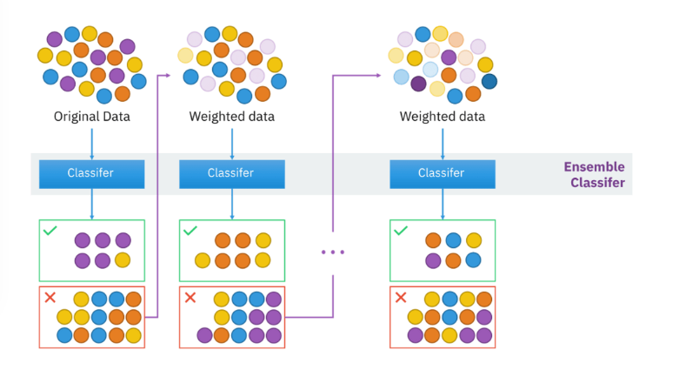
Ada boost schematic diagram

Slide 5
XGBoost
Principle:
Boosting Technique: XGBoost stands for extreme Gradient Boosting. It's an advanced version of the gradient boosting method, which combines the predictions of several simple models (usually decision trees) to make a final prediction.
Application:
Predicting Continuous Values: XGBoost regression is used to predict continuous values, like house prices, stock prices, or any other numerical outcome based on input data.
Advantages:
High Performance: XGBoost often outperforms many other algorithms because it efficiently handles large datasets, manages missing values well, and prevents overfitting using techniques like regularization.
Speed: XGBoost is faster than many other boosting algorithms because it optimizes computation and supports parallel processing.
Disadvantages:
Complexity: It can be more complex to understand and tune compared to simpler algorithms, making it harder for beginners to use effectively without some practice and learning.

Slide 6
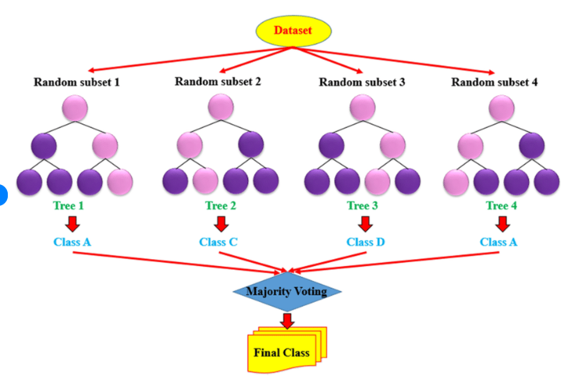
XG boost schematic diagram

Slide 7
Light Gradient Boosting Machine
Principle
Boosting Method: LightGBM uses a boosting technique where multiple weak models (usually decision trees) are combined to create a strong model. Each new model tries to correct the errors made by the previous models.
Gradient Descent: It uses gradient descent to minimize the loss (error) function. This means it iteratively improves the model by making small adjustments to reduce errors.
Application
Predictive Modeling: LightGBM is used in various fields for predictive modeling, such as finance for credit scoring, marketing for customer segmentation, and in healthcare for predicting patient outcomes.
Advantage
High Efficiency: LightGBM is very fast and efficient, especially with large datasets. It can handle large amounts of data with high speed and low memory usage.
Disadvantage
Complexity: It can be more complex to understand and tune compared to simpler models. Beginners might find it challenging to select the right parameters and understand the underlying mechanics.

Slide 8
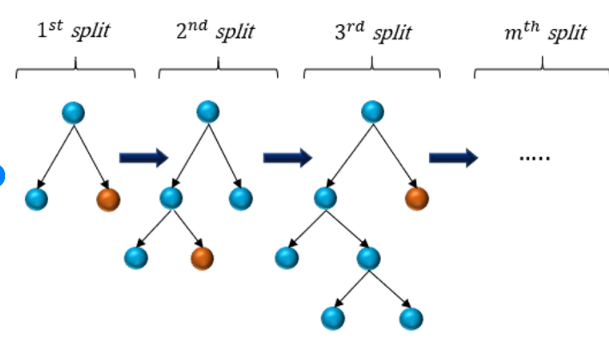
LightGBM boost schematic diagram

